Slide 1
A refresher on joint groundwater planning and GMA 12
presented to the LPGCD Board on July 21, 2021
Andrew Donnelly
Daniel B. Stephens & Associates

Slide 2
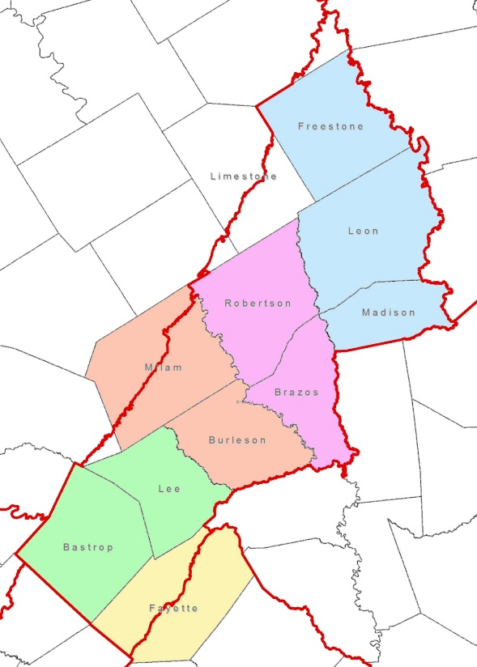
Joint Groundwater Planning
Groundwater Management Area (GMA) 12
  Lost Pines GCD
  Fayette County GCD
  Brazos Valley GCD
  Post Oak Savannah GCD
  Mid-East Texas GCD
Third round of planning
  First round completed in 2011
  Second round completed in 2016

Slide 3
DFCs
Desired Future Conditions
Desired future conditions, such as specified drawdowns, saturated aquifer thickness, or spring flow, are criteria adopted by district representatives in a groundwater management area during joint planning (from TWDB guidance document)
Basically it is what you want your aquifer(s) to “look like” at some point in the future

Slide 4
DFCs
Water levels (or drawdowns) is the most common DFC and is what is used in GMA 12
Must be quantifiable. They need to exactly define (numerically) a specific condition about the aquifer
Typically related to a specific condition 50 years in the future to match RWP planning period
Must be physically possible

Slide 5
Example DFCs
“The average drawdown in the Simsboro Aquifer in the Lost Pines GCD should be 240 feet by 2070.”
“Must maintain at least 100 acre-feet per month of stream/spring flow in Salado Creek during a repeat of the drought of record.”
“At least 80 percent of volume in storage in Hemphill County will remain in 50 years.”

Slide 6
Some Notes About DFCs
DFCs are aquifer conditions (e.g. drawdowns)
DFCs are not pumpage
DFCs are the only thing adopted/approved by the GMAs during joint groundwater planning
The use of a new GAM significantly impacts the drawdowns calculated

Slide 7
MAG
Modeled Available Groundwater
Modeled available groundwater is the amount of groundwater pumping that will achieve the desired future condition(s) (from TWDB guidance document)
Essentially the “availability” of water from an aquifer
It is not the physical availability, but rather is an amount based on policy + science
Policy side are the DFCs that are decided by the GMA and adopted by the GCDs
Calculations will be made or verified by TWDB staff using the GAM
Importantly, MAGs are not a permitting cap

Slide 8
How it typically works
GMAs meet, review material (data, GAM, nine factors, stakeholder input)
GMAs typically develop GAM runs to support DFC development
GMAs choose a set of DFCs based on material reviewed, stakeholder input, and GAM runs conducted
These are the DFCs!! Once approved, they stand on their own.

Slide 9
GAM Runs by GMAs
GMAs develop GAM runs to evaluate impact of potential pumping scenarios on aquifer conditions.
Policy-makers should understand the impact of policy decisions prior to adopting these decisions
“First knowing the answer” is recommended by the TWDB (Mace and others, 2008)
Without the use of GAMs by the GMAs, everything would fall on the TWDB

Slide 10
GMA 12 Modeling
Working with the newly updated GAM
Updated GAM produces significantly different results than previous GAM
Current working “baseline” simulation is called S-12 (aka PS-12)
S-7 is a slightly older version of S-12, minor differences in pumpage in BVGCD
Pumpage included in the baseline pumping file was based on anticipated growth (from RWP) and existing permits

Slide 11
Impact of Updated GAM
Additional runs were done to try and meet existing DFCs using the new model.
Existing DFCs in the upper aquifers (Sparta, Queen City, Carrizo) are not feasible across the GMA regardless of the pumpage, even if pumpage is reduced to zero.
Existing DFCs in deeper (Wilcox) aquifers are feasible, but result in higher MAGs.
The current DFCs (from the second round of planning) will not work with the new GAM. Readopting the previous DFCs is not an option.

Slide 12
Current DFCs and MAGs
 | DFC
 | (feet)
Sparta | 5
Queen City | 15
Carrizo | 62
Calvert Bluff | 100
Simsboro | 240
Hooper | 165
Adopted in 2017
 | 2020 | 2030 | 2040 | 2050 | 2060 | 2070
 | (afy) | (afy) | (afy) | (afy) | (afy) | (afy)
Sparta | 2,390 | 2,391 | 2,392 | 2,390 | 2,391 | 2,393
Queen City | 1,315 | 1,315 | 1,315 | 1,315 | 1,315 | 1,315
Carrizo | 7,618 | 8,358 | 9,263 | 11,800 | 12,052 | 12,052
Calvert Bluff | 2,224 | 2,631 | 3,181 | 3,909 | 3,983 | 3,984
Simsboro | 32,246 | 32,894 | 33,342 | 34,513 | 30,843 | 30,303
Hooper | 713 | 857 | 1,048 | 1,295 | 1,296 | 1,255
Carrizo-Wilcox | 42,801 | 44,740 | 46,834 | 51,517 | 48,174 | 47,594

Slide 13
S-12 Pumpage vs. Existing MAGs
 |  | 2020 | 2030 | 2040 | 2050 | 2060 | 2070
Sparta | Existing MAG | 2,390 | 2,391 | 2,392 | 2,390 | 2,391 | 2,393
 | S-12 Pumpage | 1,046 | 1,260 | 1,523 | 1,849 | 2,256 | 2,766
Queen City | Existing MAG | 1,315 | 1,315 | 1,315 | 1,315 | 1,315 | 1,315
 | S-12 Pumpage | 1,108 | 1,219 | 1,339 | 1,471 | 1,615 | 1,774
Carrizo | Existing MAG | 7,618 | 8,358 | 9,263 | 11,800 | 12,052 | 12,052
 | S-12 Pumpage | 4,715 | 5,902 | 7,237 | 8,788 | 10,655 | 12,981
Calvert Bluff | Existing MAG | 2,224 | 2,631 | 3,181 | 3,909 | 3,983 | 3,984
 | S-12 Pumpage | 2,155 | 2,815 | 3,485 | 4,166 | 4,858 | 5,563
Simsboro | Existing MAG | 32,246 | 32,894 | 33,342 | 34,513 | 30,843 | 30,303
 | S-12 Pumpage | 24,240 | 106,393 | 111,265 | 116,149 | 121,046 | 125,958
Hooper | Existing MAG | 713 | 857 | 1,048 | 1,295 | 1,296 | 1,255
 | S-12 Pumpage | 1,690 | 1,985 | 2,289 | 2,605 | 2,933 | 3,273

Slide 14
Summary of Current DFCs and S-12 Drawdowns
 | Current DFC | S-12 Drawdown (1999-2069) | S-12 Drawdown (2010-2070)
 | (feet) | (feet) | (feet)
Sparta | 5 | 27 | 22
Queen City | 15 | 31 | 28
Carrizo | 62 | 146 | 139
Calvert Bluff | 100 | 165 | 156
Simsboro | 240 | 330 | 313
Hooper | 165 | 186 | 174
NOTE: Because of the use of a new GAM, DFCs should be shifted from 1999 - 2070 to 2010 - 2070

Slide 15
Vista Ridge
Two Issues
  Vista Ridge/GMA 12
  Actual impact of Vista Ridge pumpage on wells in Lee County
Vista Ridge permits were issued by the Post Oak Savannah GCD in 2004-2008
15,000 afy in the Carrizo; 40,835 afy in the Simsboro
Pumpage began on April 15, 2020

Slide 16
Vista Ridge Impacts
Although the Simsboro pumpage is greater, the Simsboro wells are much deeper, and therefore fewer wells in Lost Pines are expected to be impacted. Simsboro also more productive.
Carrizo production is now causing the problems in Lost Pines, specifically northern Lee County east of Lexington
Drawdowns will be most significant when the well field is initially turned on, declines lessen as time goes on

Slide 17
Vista Ridge and GMA 12
Existing Carrizo MAGs in POSGCD less than current Vista Ridge project Carrizo pumpage
When Vista Ridge pumpage was included in the most recent GMA 12 simulations, the drawdowns were greater than POSGCD wanted for the Carrizo Aquifer
Vista Ridge pumpage has also impacted Lost Pines Carrizo drawdowns
POSGCD wants to limit drawdowns (DFCs) in the Carrizo, which requires limiting the pumpage in the Carrizo within their district– most Carrizo pumpage is Vista Ridge

Slide 18
Vista Ridge and GMA 12
Lowering Vista Ridge pumpage in the current GMA 12 run may need to have to lower the DFC in Lost Pines (depending on the variance in the DFC)
Lost Pines has no ability to manage to the DFC because the Carrizo pumpage in Lee County is very low– all of the impact is from the Vista Ridge project outside of the district
Lowering Vista Ridge pumpage in the current GMA 12 run will not impact observed water level declines in Carrizo wells in northern Lee County. Only reduction in pumpage will reduce declines.

Slide 19
Vista Ridge and GMA 12
GMA 12 said that all of the pumpage from Vista Ridge needed to be included in the GAM runs used to help develop DFCs
POSGCD disagreed with this approach and voted against the proposed DFCs
The proposed DFCs up for consideration are based on GAM Run S-12, which includes all Vista Ridge pumpage

Slide 20
Proposed “DFC Zones”
DFCs are currently District-wide averages, even though pumpage does not occur in each aquifer across the entire District.
Monitoring drawdowns across the entire District is impossible due to the availability of wells.
Alternative approach would shrink the DFC monitoring zones to the aquifer outcrop and shallow(er) downdip, where most of the wells are present.

Slide 21
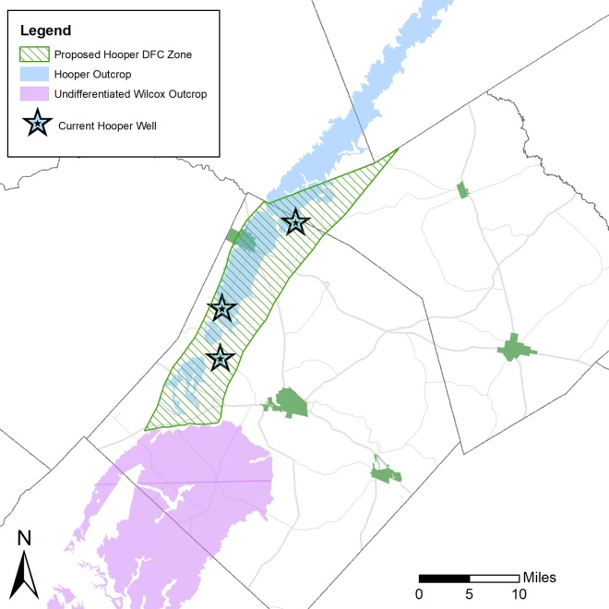

Slide 22
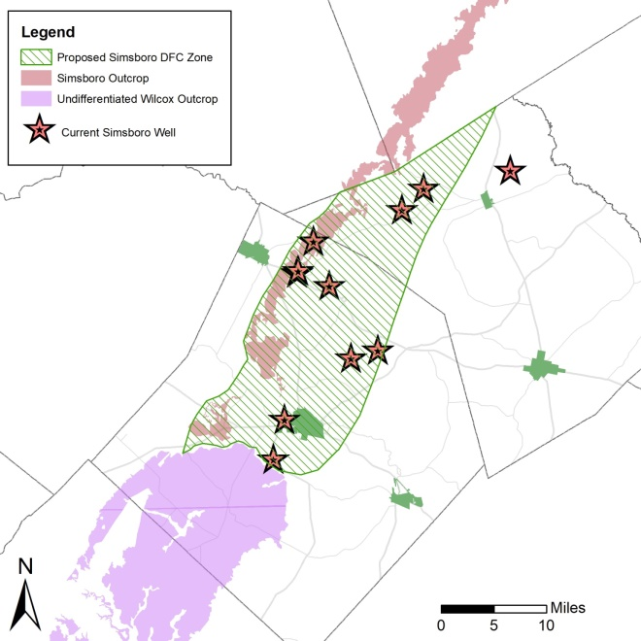

Slide 23
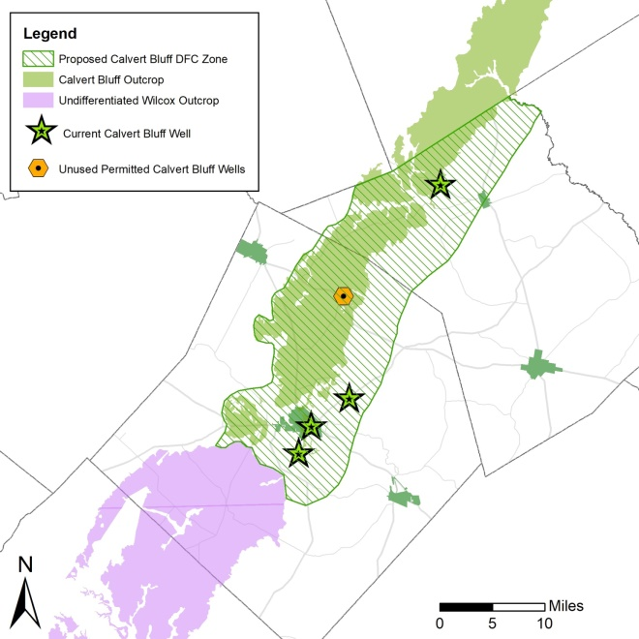

Slide 24
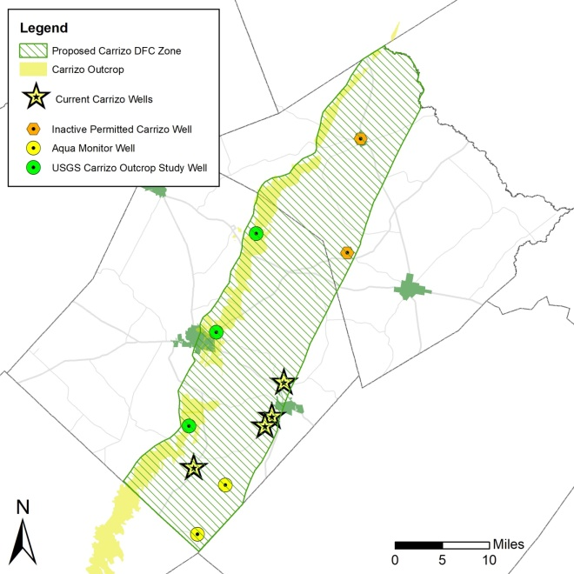

Slide 25
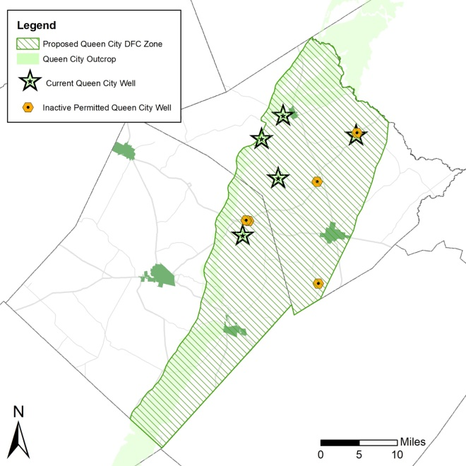

Slide 26
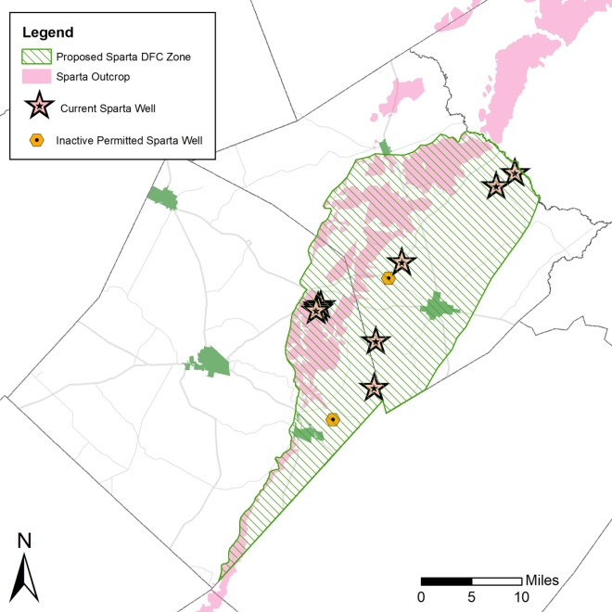

Slide 27
Impact of “DFC Zones”
Evaluation of S-12 using the new GAM
Drawdowns for 2010 - 2070
 | County Average Drawdowns | DFC Zone Drawdowns
 | (feet) | (feet)
Sparta | 22 | 19
Queen City | 28 | 27
Carrizo | 139 | 94
Calvert Bluff | 156 | 83
Simsboro | 313 | 201
Hooper | 174 | 43

Slide 28
DFC Zones
DFC zones are not management zones/areas (as defined in District Rule 9.2)
DFC zones are simply revising the area that DFCs are calculated and monitored from county-wide to those areas that are where most users are located and wells are present that can be used to monitor water levels
The District has not yet adopted the DFC Zones

Slide 29
Timeline
Summer 2021- GCDs hold public hearings, receive comments on proposed DFCs
Late Summer/early Fall 2021- GMA reconvenes to discuss comments received
January 5, 2022- Final DFCs must be adopted by GMA 12
+60 days- Explanatory Report and supporting materials submitted to TWDB
+90 days- TWDB must inform GMA 12 of any deficiencies

Slide 30
Summary
Joint groundwater planning
DFCs are aquifer conditions
DFCs are what is adopted by the GMAs
The MAGs are the pumpage that achieves the DFCs and is determined by the TWDB
MAGs are not a permitting cap

Slide 31
Summary
The update GAM has caused a lot of issues for GMA 12
  The existing DFCs will not work with the new GAM (specifically the upper aquifers)
  The updated GAM requires more pumpage in the deep aquifers (Wilcox) to achieve the DFCs
Therefore, the existing DFCs cannot be readopted

Slide 32
Summary
DFC Zones focus DFCs on areas where the majority of users exist and where monitoring can be done
Impacts being observed in northern Lee County from the Vista Ridge project are from actual pumpage from the Vista Ridge wells. DFCs will not fix the issues associated with Vista Ridge pumpage
How to include Vista Ridge in the model simulations has caused disagreement within GMA 12

Slide 33
Most Important Takeaways
There is still some disagreement within GMA 12 on how to handle pumpage in GAM runs
Time is critical
The current DFCs for the upper aquifers cannot be readopted, they are no longer feasible with the new GAM

Slide 34
Questions??

